Slide 1
Modern Agents an updating ckpt
五道口纳什
09/2025

Slide 2
Foundations: reasoning & planning
probe/utilize/incentivize/leverage/maximize model’s performace
classical workflow
self-critic (generator vs. critic, UCLA IMO)
multi-agents system: Separation of Concern
context engineering
memory
self-evolving: AlphaEvolve, GEPA ...
misc
langchain-langgraph
graph-based methods: neural-symbolic approach
toolset: mcp
test-time scaling: parallel thinking (DeepConf)
不断地在实践中掌握更多行之有效的 know-how！

Slide 3
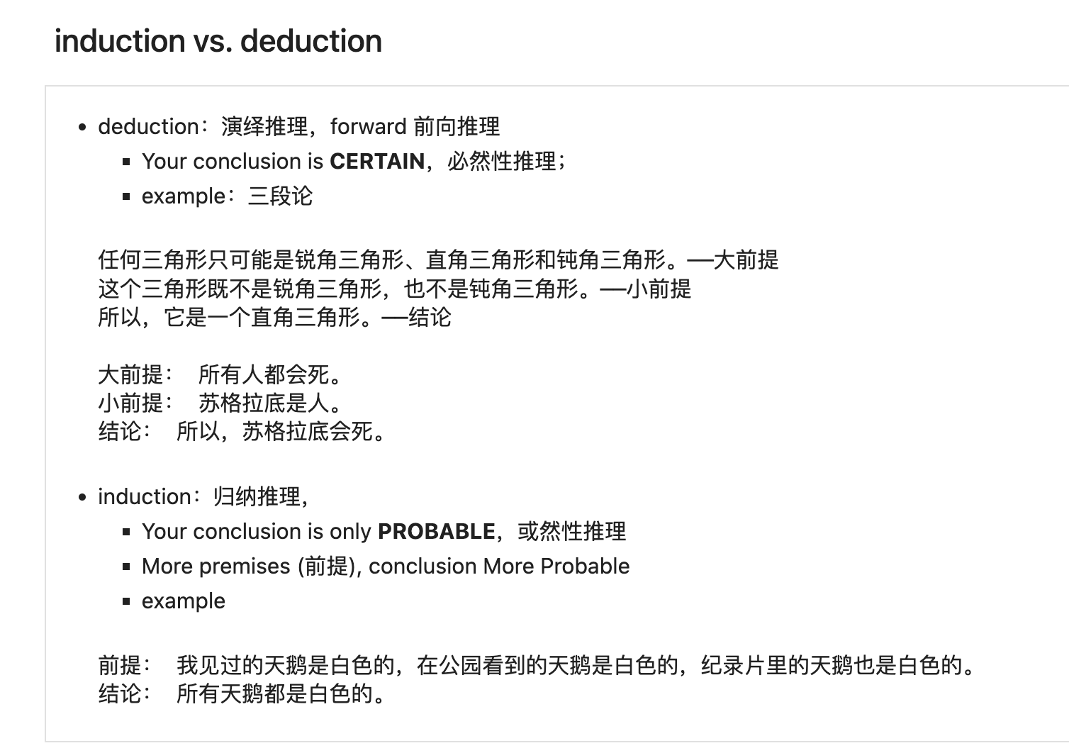
Reasoning
reasoning 体现着真正的 intelligence
“无中生有”：如何从已知（limited premises）中，沿着推理链，推导出更多更丰富的结论（new conclusions）；
Agentic 是对模型智能的兑现
被 impressed 或者觉得失望
impressed：推理出来的新知超出预期
失望：低于预期
没有 reasoning 就没有 planning (分解/think ahead)，也不会有 reflection/critic
(implicit) long cot
self-critic: paper-reading
generator: understanding
critic: 广泛地需要推理，从已知中推理出大量的非浅层的新的结论；

Slide 4
Planning
what
decomposition
think ahead, think multiple steps
why
limits of lllm to solve complex queries/tasks (long horizon, multi-hop, multi-interactions)
leverage models performance on hard tasks
how
Notes:
我有一个暴论，模型的智能的体现就是推理能力，

Slide 5
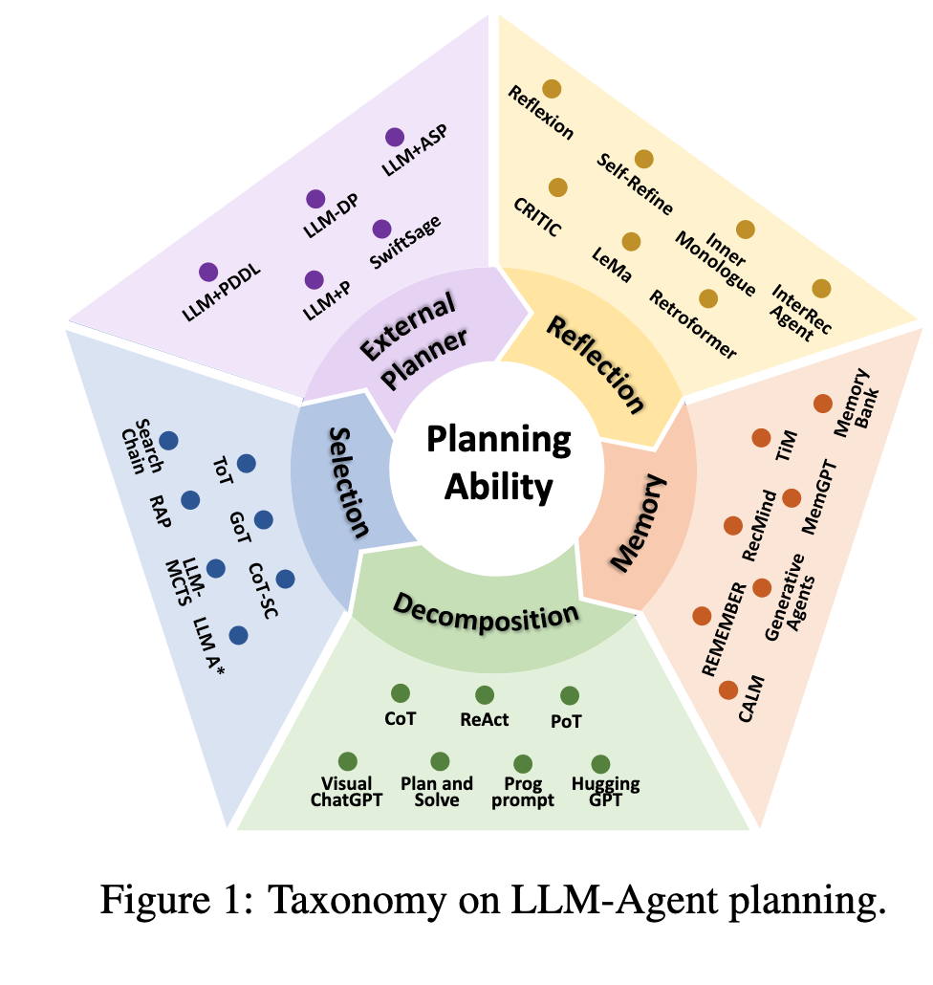
Planning of LLM Agents
Reasoning: Planning, Reflexion, ...
Planning
(implicit) reasoning models ...
prompt-based: ReAct, Plan-and-Solve, ...
search-based: ToT, LLM+MCTS...
test-time scaling: self-consistency, DeepConf...
Neural-Symbolic: DSL/Lean(AlphaGeometry)/PDDL ...
扬长避短
Understanding the planning of LLM agents: A survey
2402.02716

Slide 6
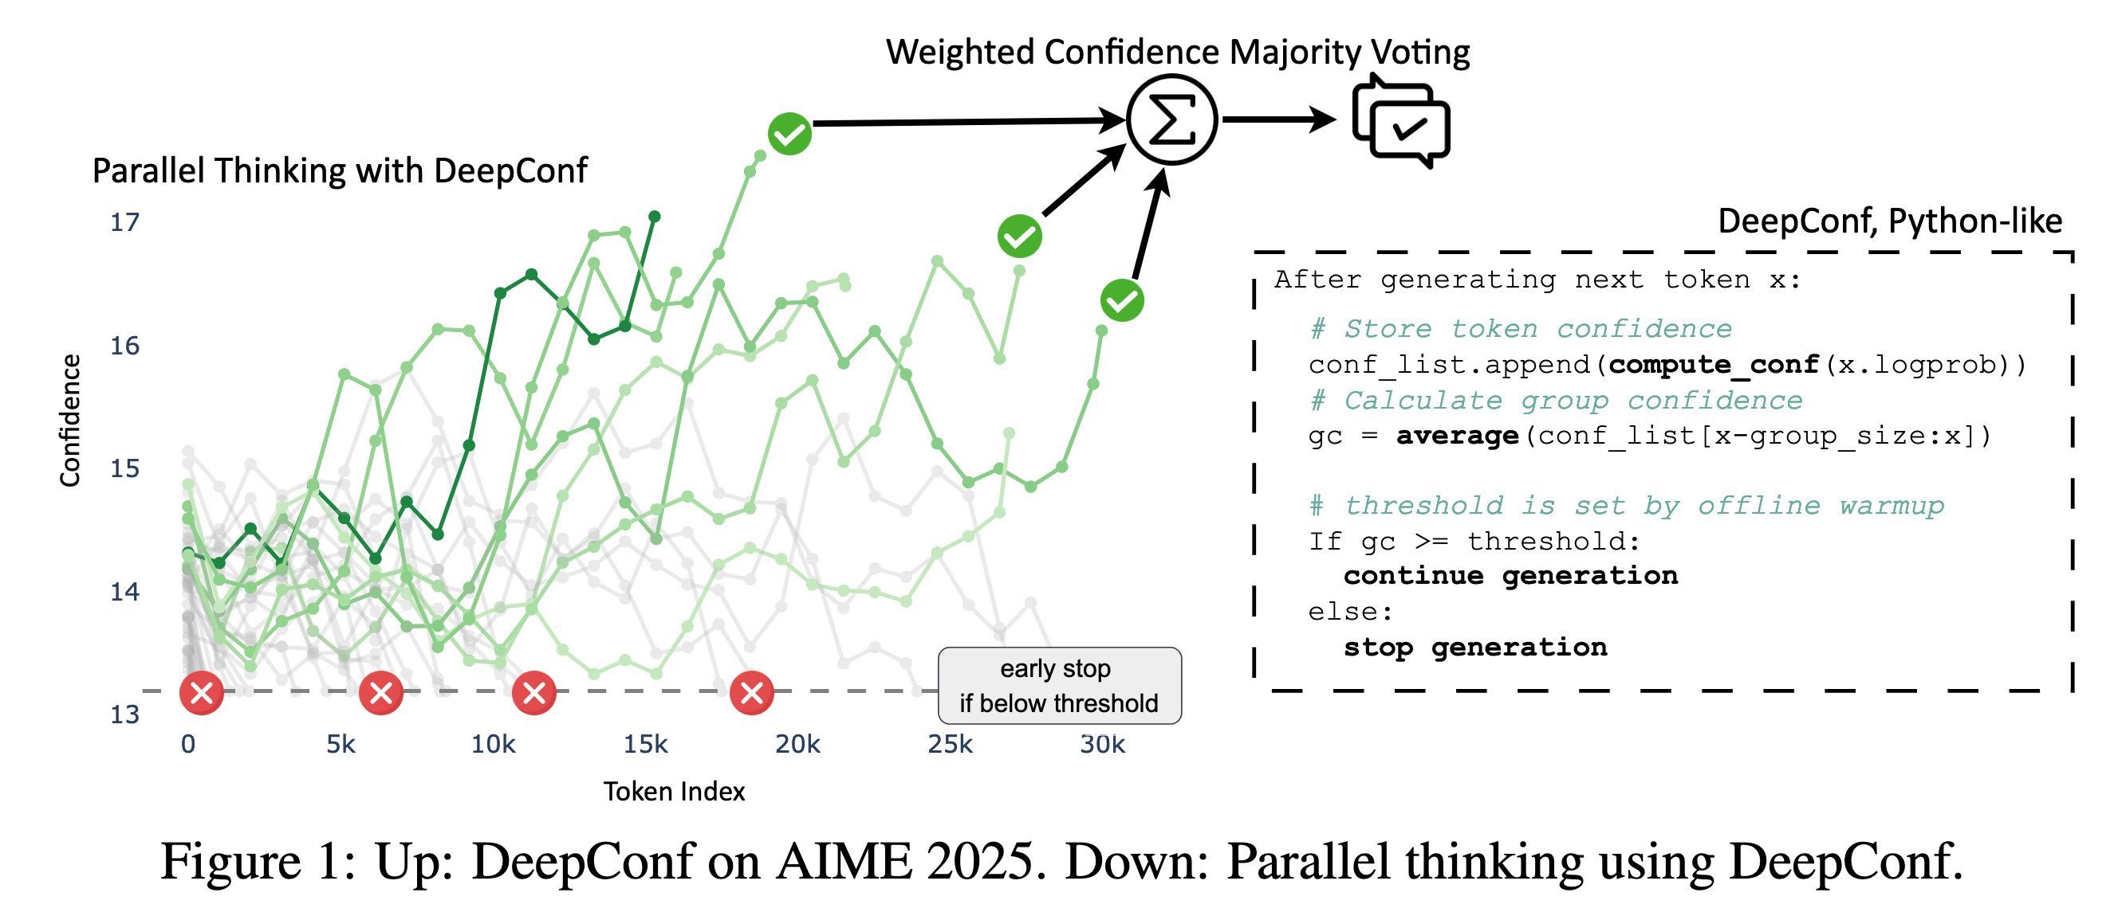
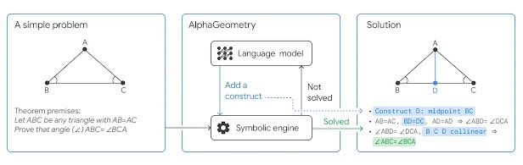
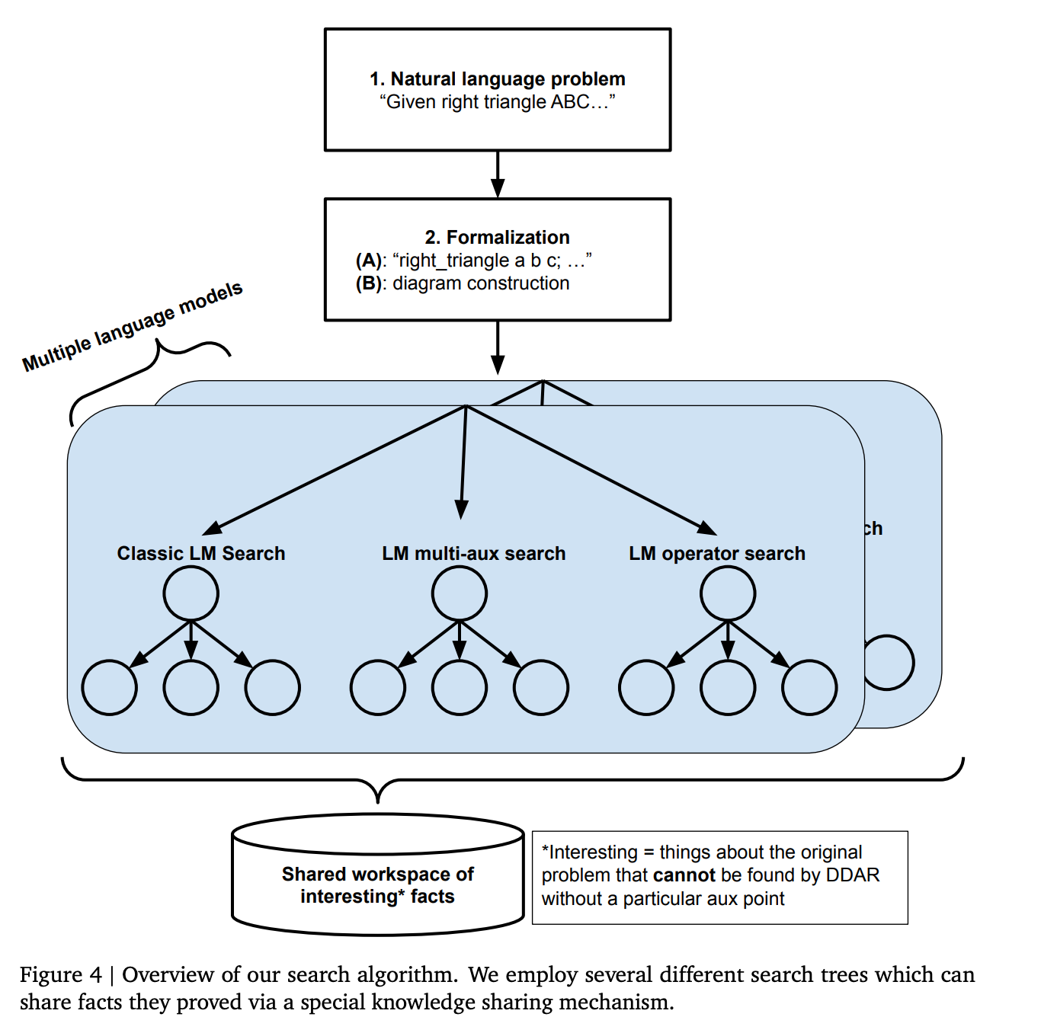
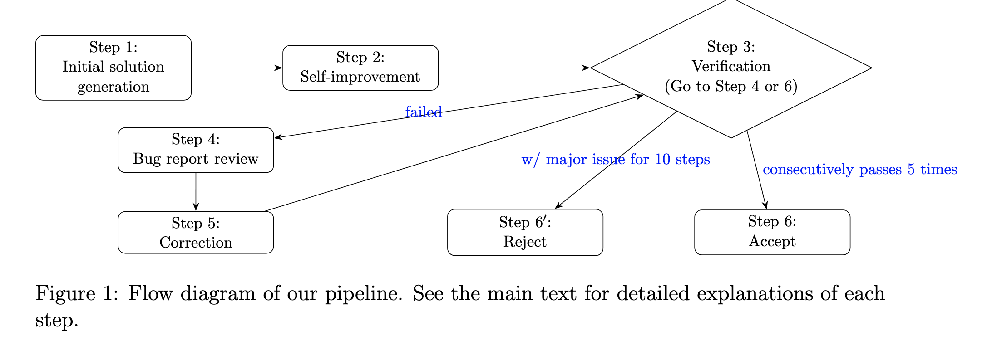
3 typical cases
Gemini 2.5 Pro Capable of Winning Gold at IMO 2025
2507.15855
design a solid evaluation(critic) prompts
AlphaGeometry & AlphaGeometry2

Slide 7
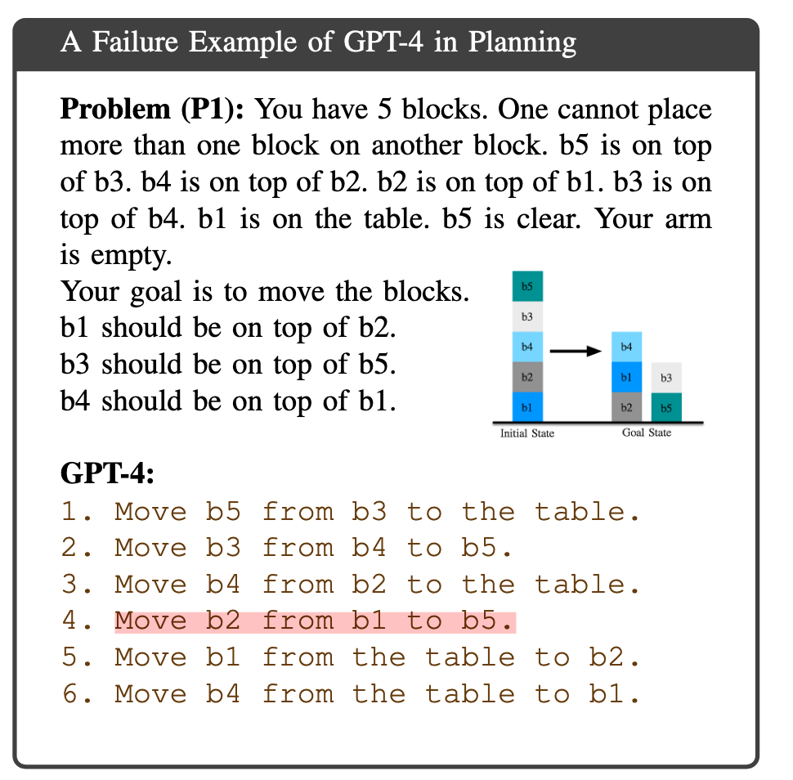
Limits of LLM Planning
Planning: complex queries/tasks (long-horizon)
Explicit long term planning (which even really strong LLMs can struggle with)
LLMs are unable to perform accurate reasoning or solve planning problems.
EAI (Embodied Agent Interface)
missing steps & additional steps
llm + p

Slide 8
ReAct => Plan-and-Solve
ReAct: Reasoning & Acting
complex long-term tasks: context issues ....
<thought, tool(action), tool_resp (obs)> * n
Plan-and-Solve
generate plan/execute steps (dynamic adaptability)
Zero-shot-CoT
Let's think step by step.
Plan-and-Solve (PS) Prompting
Let's first understand the problem and devise a plan to solve the problem. Then, let's carry out the plan and solve the problem step by step.

Slide 9
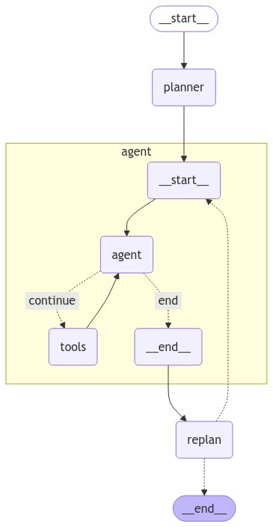
Dynamic Plan-and-Solve
brain in vat vs. truly interaction
dynamic: revise/replan
plan: list of steps
replan:
raw input
raw plan
past steps
economics
Ability to use smaller/weaker models for the execution step, only using larger/better models for the planning step
Notes:
设计/理解 langgraph 的 graph 实例其实就是理解虚边，刻画着条件分支

Slide 10
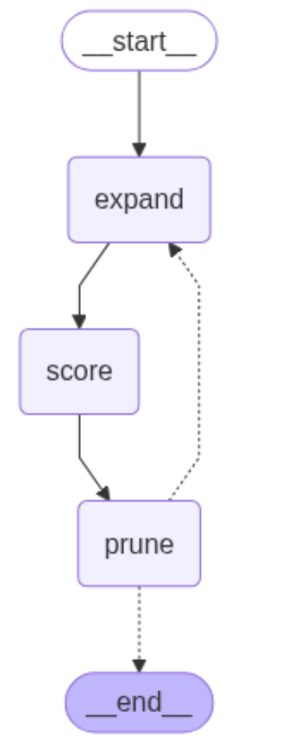
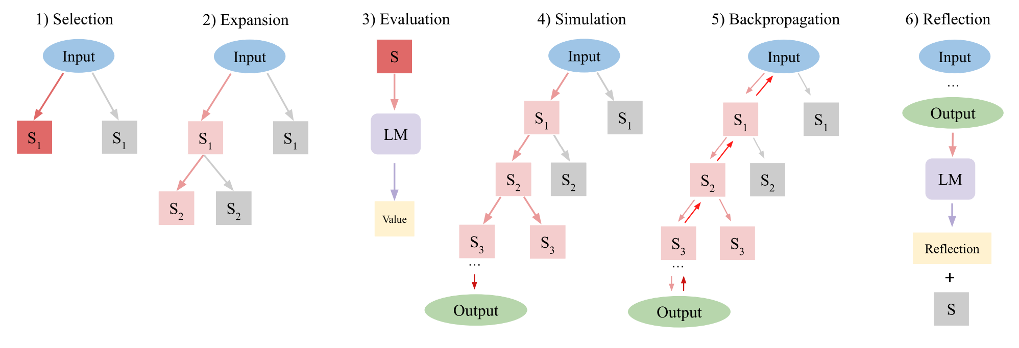
ToT & LATS (mcts)
selection: UCB
expansion:
simulation: score
bp

Slide 11
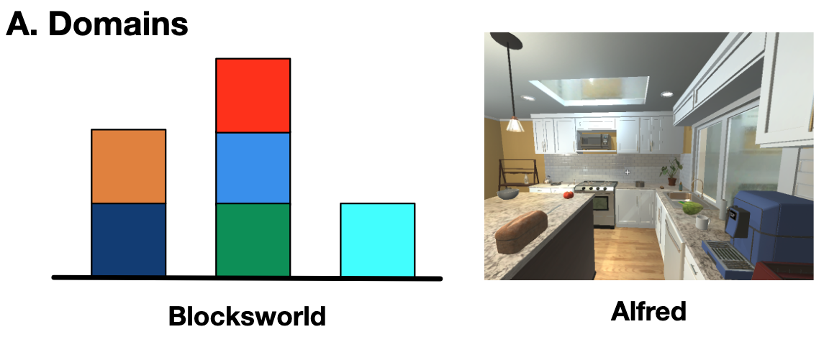
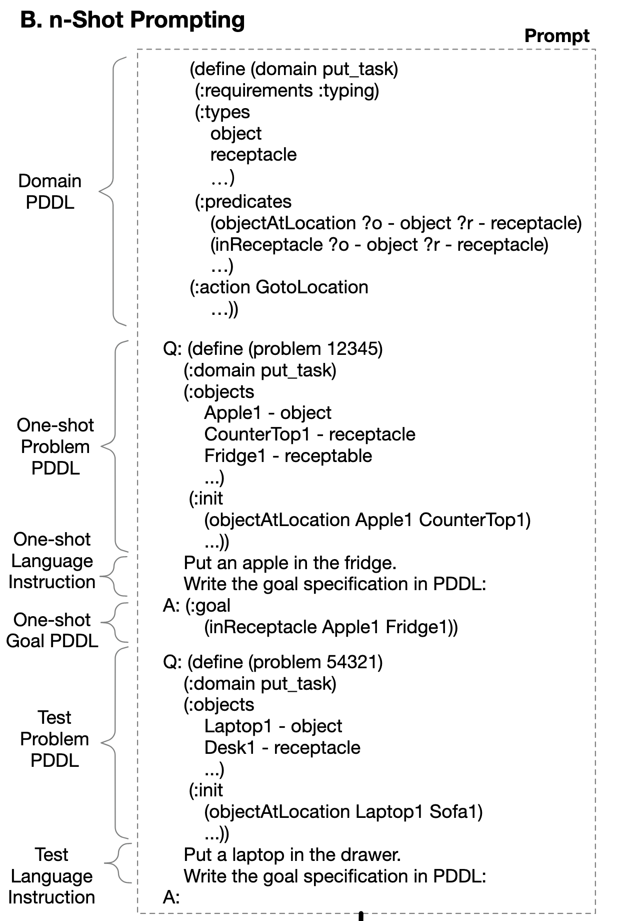
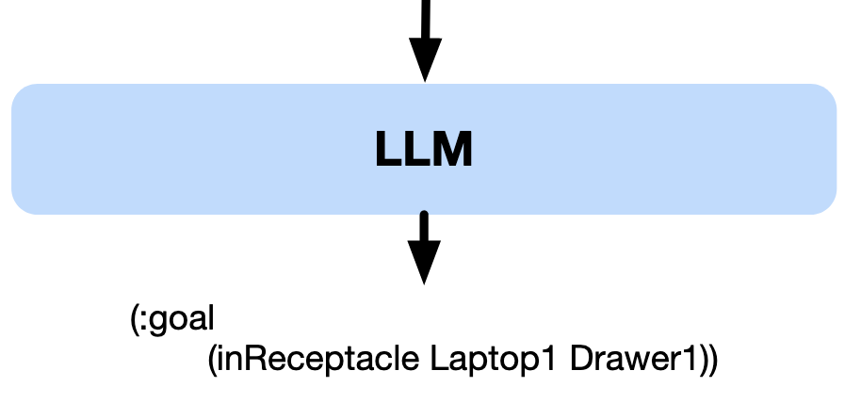
Introducing PDDL
LLMs are unable to perform accurate reasoning or solve planning problems.
LLMs are significantly more adept at translation tasks than at performing planning tasks.
Translation Subtasks
Domain Understanding
Goal Inference
PDDL Goal Specification
Translating Natural Language to Planning Goals with Large-Language Models
2302.05128
Notes:
objects analysis
affordance & actions
actions (objects) combination
affordance & values
objects spatial understanding
人去执行时，也是会先形成一个 plan 或者说往前想三步，然后执行第一步； LLMs are more effective at goal translation than at actual planning.

Slide 12
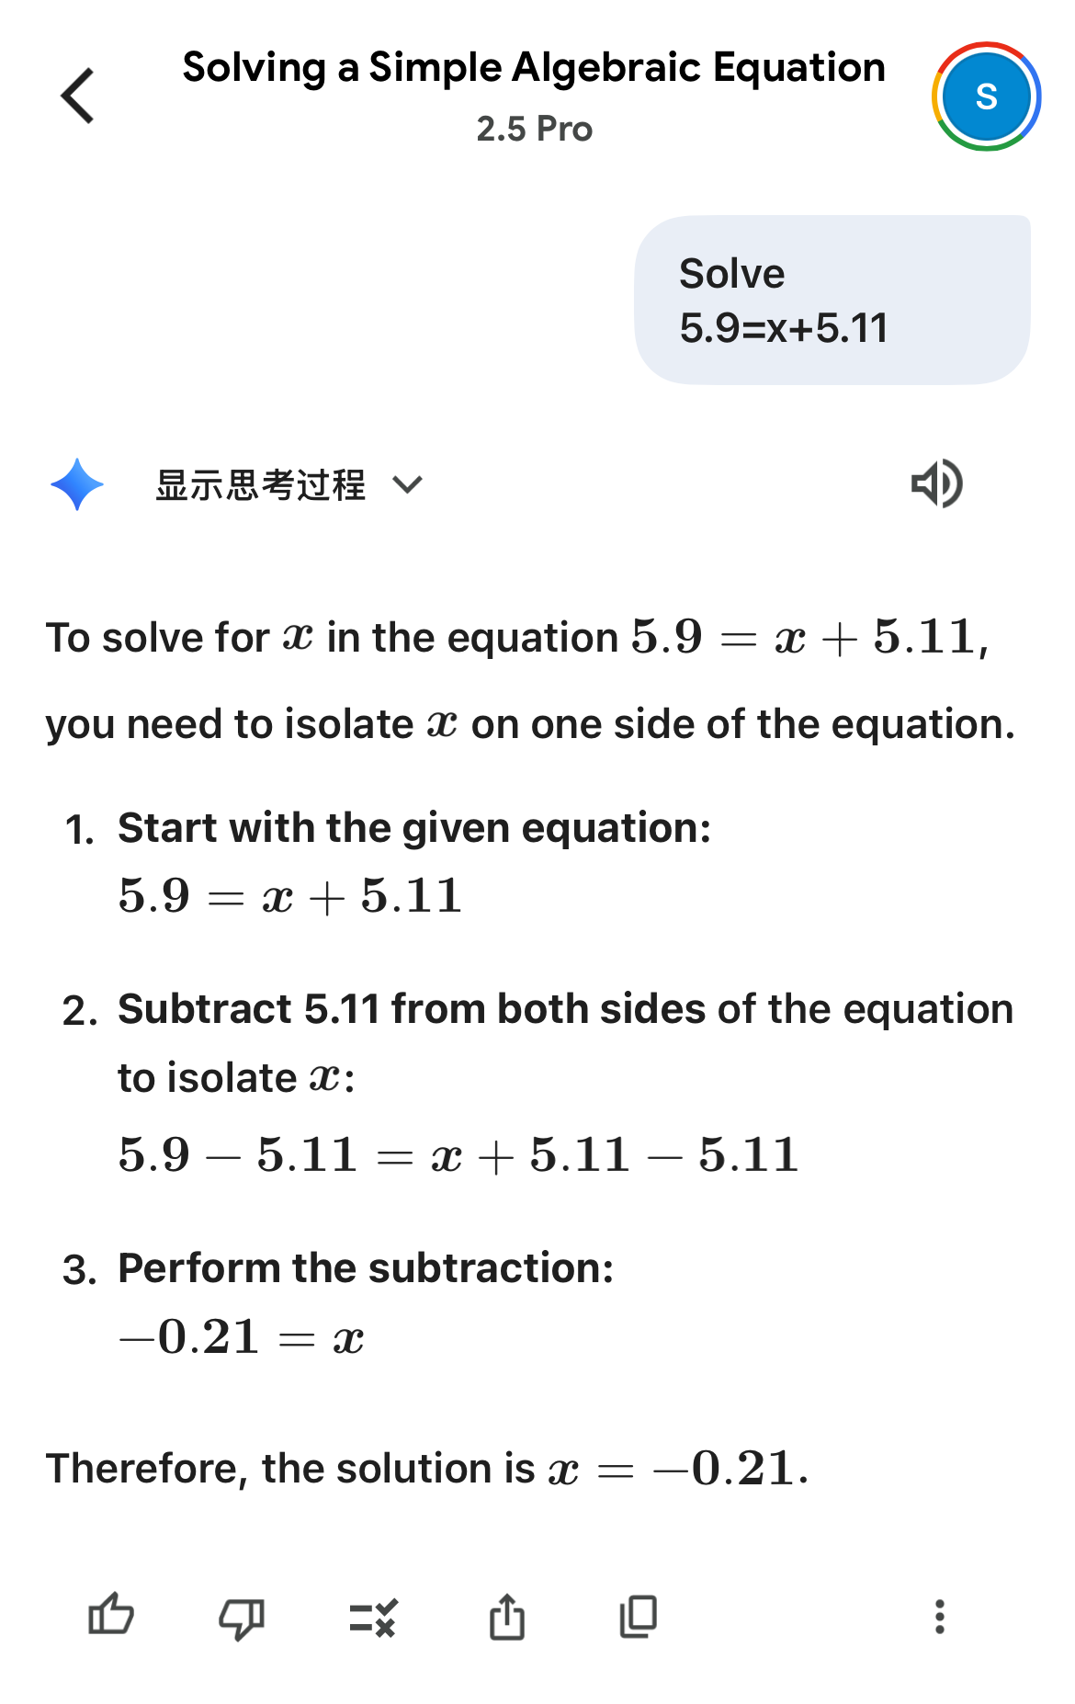
Take-aways
(explicit) plan is necessary and efficient for complex/long-term problem solving
top-down & bottom-up
top-down: decomposition
bottom-up: revise/replan, brige the gap between plan & execution
缸中之脑 => 真实交互
感知模型的能力及特点，扬长避短
设计合适的 workflow (proposal->critic->refine)，激励模型的能力/表现
寻找/封装合适的工具/external solver
llm & tools & prompts: systemic design

Slide 13
Planning Agents a typical solution
五道口纳什
10/2025

Slide 14
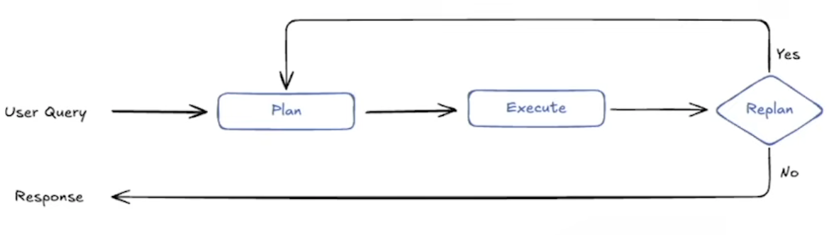
Dynamic Plan-and-Solve
Plan-and-Execute
Plan: top-down (subgoal) decomposition
output: list of steps (TODO)
introducing generator-critic mode
Execute: consume a step of plan
outcome/feedbackss
Replan: bottom-up
input: raw input/raw plan/past steps
brain in vat vs. truly interaction
economics
Ability to use smaller/weaker models for the execution step, only using larger/better models for the planning step

Slide 15
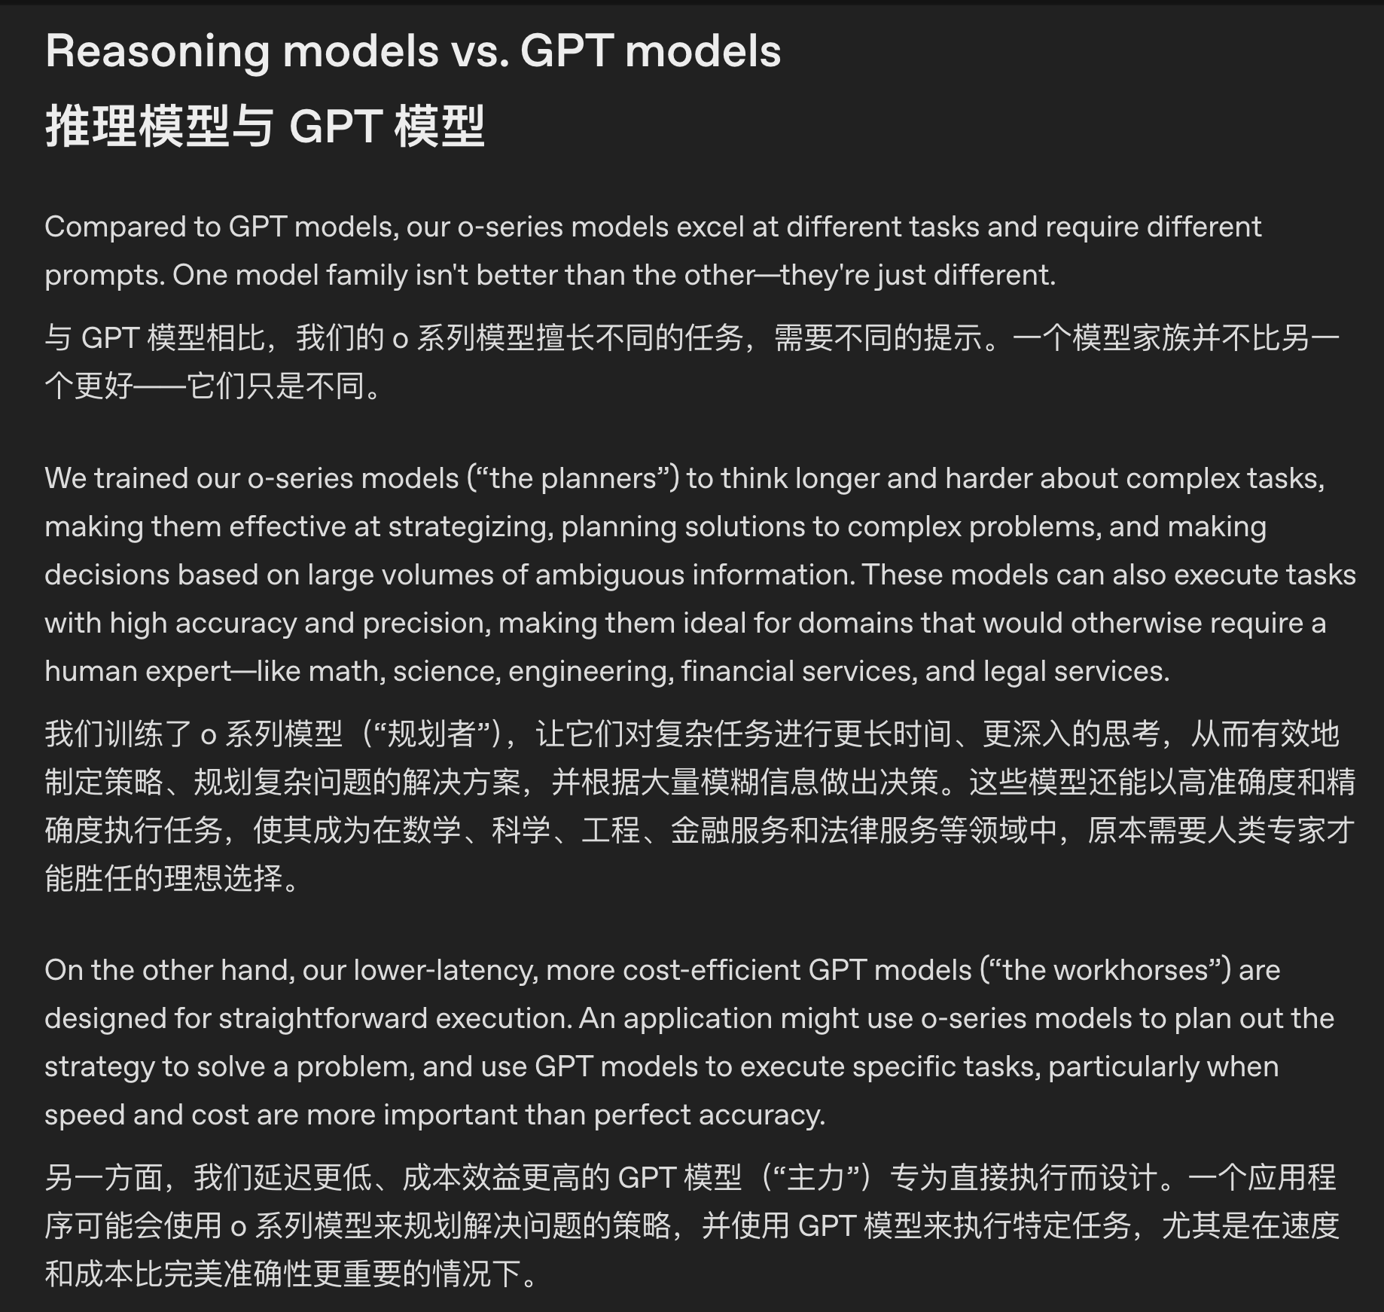
Notes:
https://platform.openai.com/docs/guides/reasoning-best-practices#reasoning-models-vs-gpt-models

Slide 16
todo

Slide 17
structured
泛化性、通用性，principled
concise
概念、原理，以及求解问题的思路要清晰；
clean code: code taste

Slide 18
ReAct
create_react_agent
langchain
langgraph
simple Reflection vs. Reflexion

Slide 19
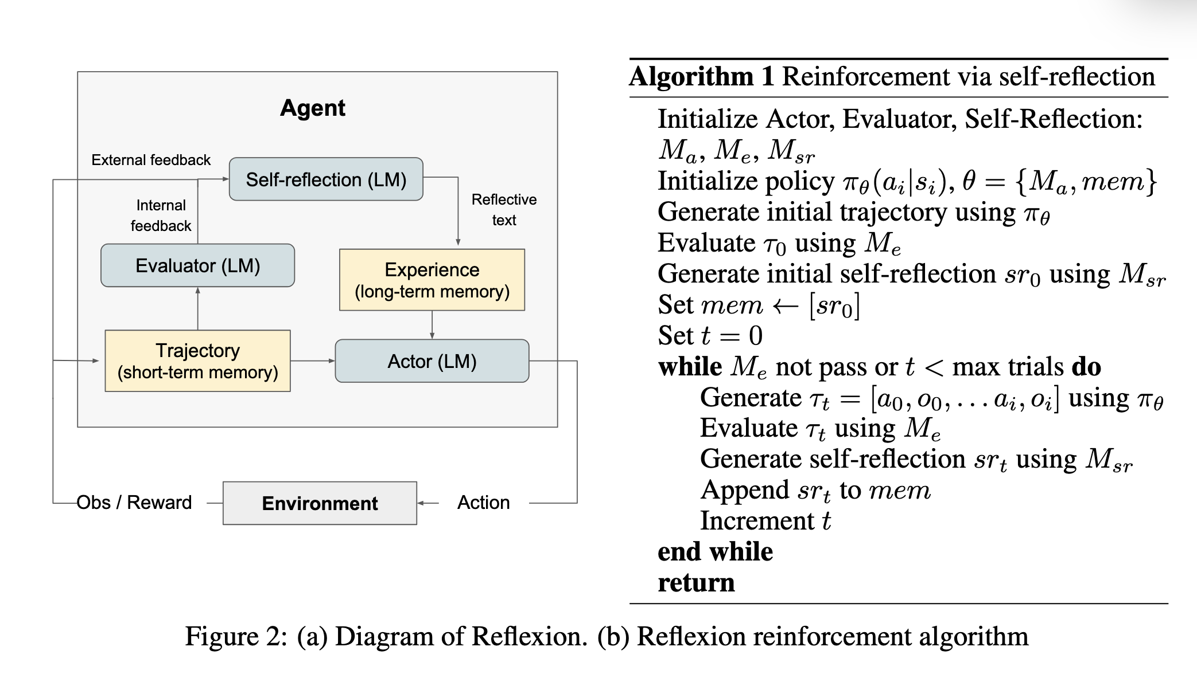
Reflection
Reflexion: EIA
error => improvment => avoid

Slide 20
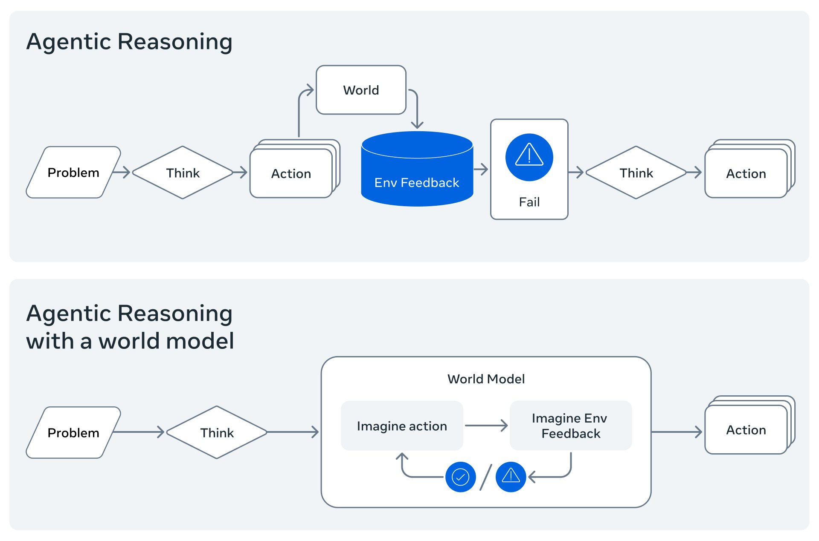
重点的是
imageine action
imageine env feedback
Notes:
*When humans plan, we imagine the possible outcomes of different actions. When we reason about code we simulate part of its execution in our head. *

Slide 21
RAG
pipeline: retriever => ranker => reranker => generator
recall
benchmark & evaluation
Fiction.LiveBench
ranker, reranker
details
chunking
Searching for Best Practices in Retrieval-Augmented Generation
2407.01219

Slide 22
Ranker 与 Reranker
BM25/向量召回 N=400 → 轻排序保留 M=80 → Cross-encoder 精排取 k=8 → 上下文拼接（去重+MMR）。

